Slide 1


DEPARTMENT OF PHYSICS AND NANOTECHNOLOGY
SRM INSTITUTE OF SCIENCE AND TECHNOLOGY
18PYB103J –Semiconductor Physics
Module-II Lecture-III
Carrier Generation & Carrier Recombination
18PYB103J Module-II Lecture-3

Slide 2
Carrier Generation & Recombination
Carrier generation describes processes by which electrons gain energy and move from the valence band to the conduction band, producing two mobile carriers; while recombination describes processes by which a conduction band electron loses energy and re-occupies the energy state of an electron hole in the valence band.
Semiconductors are characterized by two types of mobile carriers, electrons in the conduction band and holes in the valence band. The generation rate gives the number of electrons generated at each point in the device due to the absorption of photons..
Excess carriers, essential for device operation, are created by optical excitation, electron. bombardment, or injected across a forward-biased p-n junction. • These excess carriers can dominate the conduction process in semiconductor materials.
18PYB103J Module-II Lecture-3

Slide 3
In semiconductors several different processes exist which lead to generation or recombination, the most important ones are:
Photon transition (or) Optical generation/recombination
Phonon transition (or) Shockley-Read-Hall generation/recombination
Auger generation/recombination (or) Three particle transitions
Impact ionization
In thermal equilibrium the generation and recombination processes are in dynamic equilibrium. When the system is supplied with additional energy, for example through the absorption of photons or the influence of temperature, additional carriers are generated. The most important generation/recombination processes for the simulation of semiconductor devices are summarized in the following.
18PYB103J Module-II Lecture-3

Slide 4
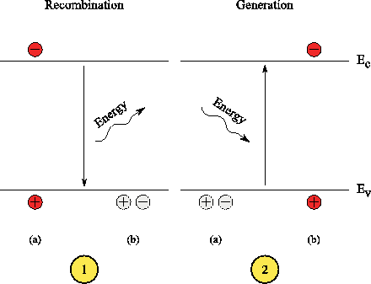
1. Photon Transition
Direct generation/recombination process. During photon assisted recombination an electron from the conduction band re-combines with a hole in the valence band. The excess energy is transferred to a photon. The reverse process obtains its energy from radiation and generates an electron hole pair.
18PYB103J Module-II Lecture-3

Slide 5
The photon transition is a direct, band-to-band, generation/recombination process. An electron from the conduction band falls back to the valence-band and releases its energy in the form of a photon (light).
The reverse process, the generation of an electron-hole pair, is triggered by a sufficiently energetic photon which transfers its energy to a valence band electron which is excited to the conduction band leaving a hole behind. The photon energy for this process has to be at least of the magnitude of the band-gap energy.
18PYB103J Module-II Lecture-3

Slide 6
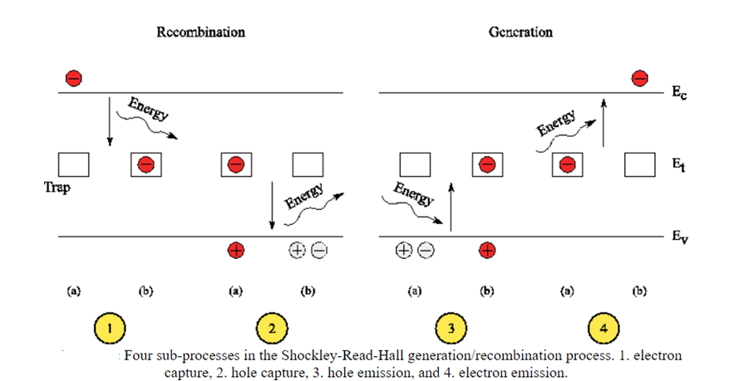
2. Phonon Transition (OR) Shockley-Read-Hall generation/recombination
18PYB103J Module-II Lecture-3

Slide 7
Another process is the generation/recombination by phonon emission. This process is trap-assisted utilizing a lattice defect at the energy level E_{t} within the semiconductor band-gap. The excess energy during recombination and the necessary energy for generation is transferred to and from the crystal lattice (phonon). A theory describing this effect has been established by Shockley, Read, and Hall. Therefore, the effect is throughout the literature referenced as Shockley-Read-Hall (SRH) generation/recombination. Four sub-processes are possible:
Electron capture. An electron from the conduction band is captured by an empty trap in the band-gap of the semiconductor. The excess energy of E_{c} - E_{t} is transferred to the crystal lattice (phonon emission).
Hole capture. The trapped electron moves to the valence band and neutralizes a hole (the hole is captured by the occupied trap). A phonon with the energy E_{t} -E_{v} is generated.
18PYB103J Module-II Lecture-3

Slide 8
Hole emission. An electron from the valence band is trapped leaving a hole in the valence band (the hole is emitted from the empty trap to the valence band). The energy necessary for this process is E_{t} - E_{v}.
Electron emission. A trapped electron moves from the trap energy level to the conduction band. For this process additional energy of the magnitude E_{c} - E_{t} has to be supplied.
18PYB103J Module-II Lecture-3

Slide 9
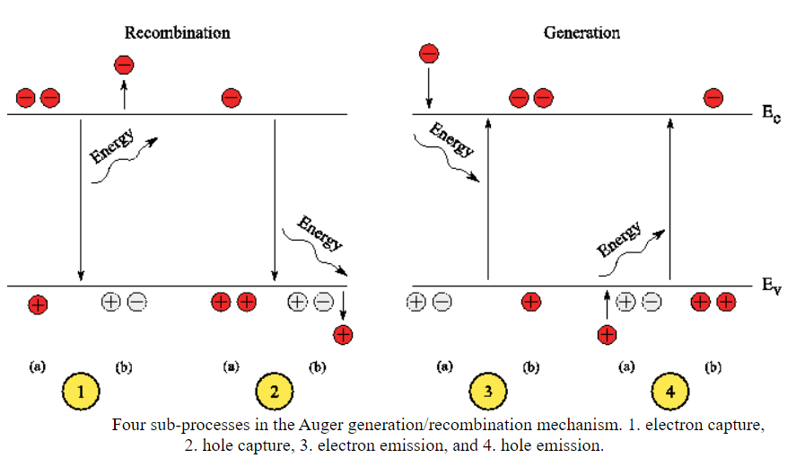
3. Auger generation/recombination (or) Three particle transitions
18PYB103J Module-II Lecture-3

Slide 10
In the direct band-to-band Auger mechanism three particles are involved. During generation an electron hole pair is generated consuming the energy of a highly energetic particle. In the opposite process, when an electron hole pair recombines, the excess energy is transferred to a third particle. In detail the four possible processes are as follows:
Electron capture. An electron from the conduction band moves to the valence band neutralizing a hole in the valence band. The excess energy is transferred to an electron in the conduction band.
Hole capture. Again, an electron from the conduction band moves to the valence band and recombines with a valence hole. The excess energy is, in contrast to Process 1, transferred to another hole in the valence band.
Electron emission. A highly energetic electron from the conduction band transfers its energy to an electron in the valence band. The valence electron moves to the conduction band generating an electron hole pair.
Hole emission. A highly energetic hole from the valence band transfers its energy to an electron in the valence band which is then excited to the conduction band generating an electron hole pair.
18PYB103J Module-II Lecture-3

Slide 11
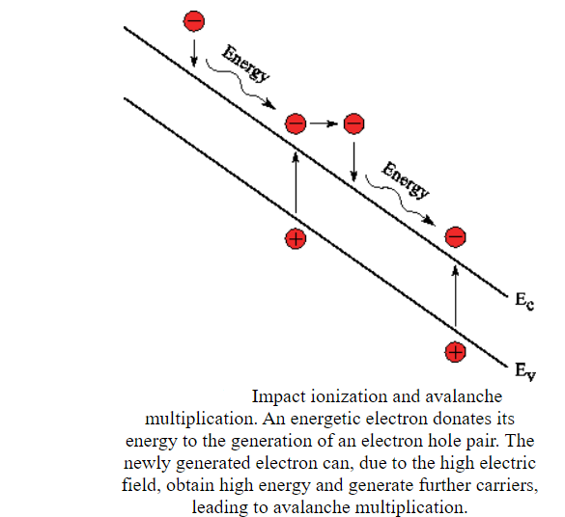
4. Impact ionization
18PYB103J Module-II Lecture-3

Slide 12
Impact ionization is a pure generation process. Microscopically it is exactly the same mechanism as the generation part of the Auger process: a highly energetic carrier moves to the conduction or valence band, depending on the carrier type, and the excess energy is used to excite an electron from the valence band to the conduction band generating another electron hole pair. The major difference is the cause of the effect. While it is purely the carrier concentration in the Auger mechanism, for impact ionization it is the current density.
Two partial processes can be distinguished:
Electron emission. A highly energetic electron from the conduction band transfers its energy to an electron in the valence band. The valence electron moves to the conduction band generating an electron hole pair.
Hole emission. A highly energetic hole from the valence band transfers its energy to an electron in the valence band which is then excited to the conduction band generating an electron hole pair.
18PYB103J Module-II Lecture-3

